Slide 1
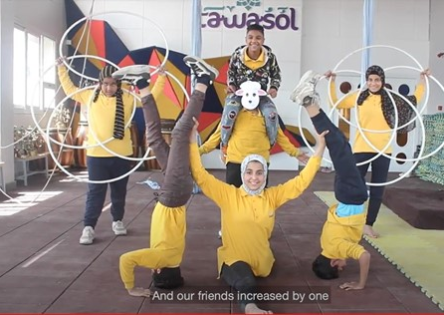
Stories, Communities, Voices: Revitalising Language Learning through Digital Storytelling
Dr Vicky Macleroy
v.macleroy@gold.ac.uk
Centre for Language, Culture and Learning
Goldsmiths, University of London

Slide 2
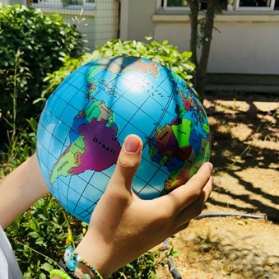
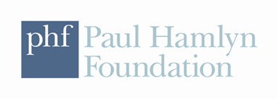
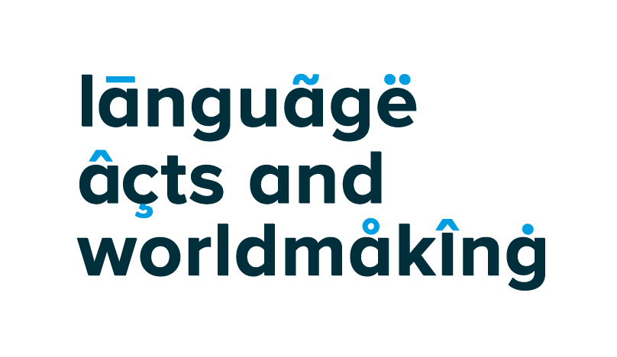
Critical Connections Project (2012-ongoing) Project-Based Language Learning (PBLL) using digital technologies
‘Digital storytelling opens up space for experimentation, for multimodal and potentially multilingual bricolage, for expanding lifeworlds, and for developing voice’ (p. 232).
Anderson, J. & Macleroy, V. (2021) Stories, Communities, Voices: Revitalising Language Learning Through Digital Media within a Project-based Pedagogical Framework. In M. Thomas and K. Yamazaki (eds) Project-Based Language Learning and CALL: From Virtual Exchange to Social Justice. Sheffield: Equinox Publishing Ltd, pp 245-276.

Slide 3
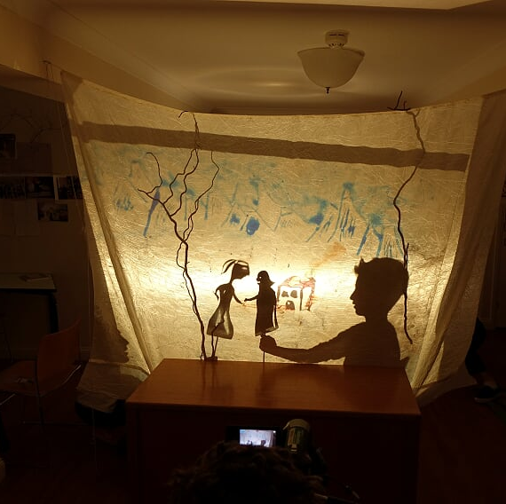
Key characters on the stage Teachers
The process of multi-lingual film making has allowed our students to experiment and play with languages and digital technology at an advanced level. I can't imagine any other project stimulating so many aspects of the young learner. Digital skills, collaboration, problem solving, nuanced language translation as well as the joy expressing yourself through art. These students are skilled and ready for employment in the 21st century.
Marc Smith, Lead Project Teacher, 2017 (Croatian-English film)

Slide 4
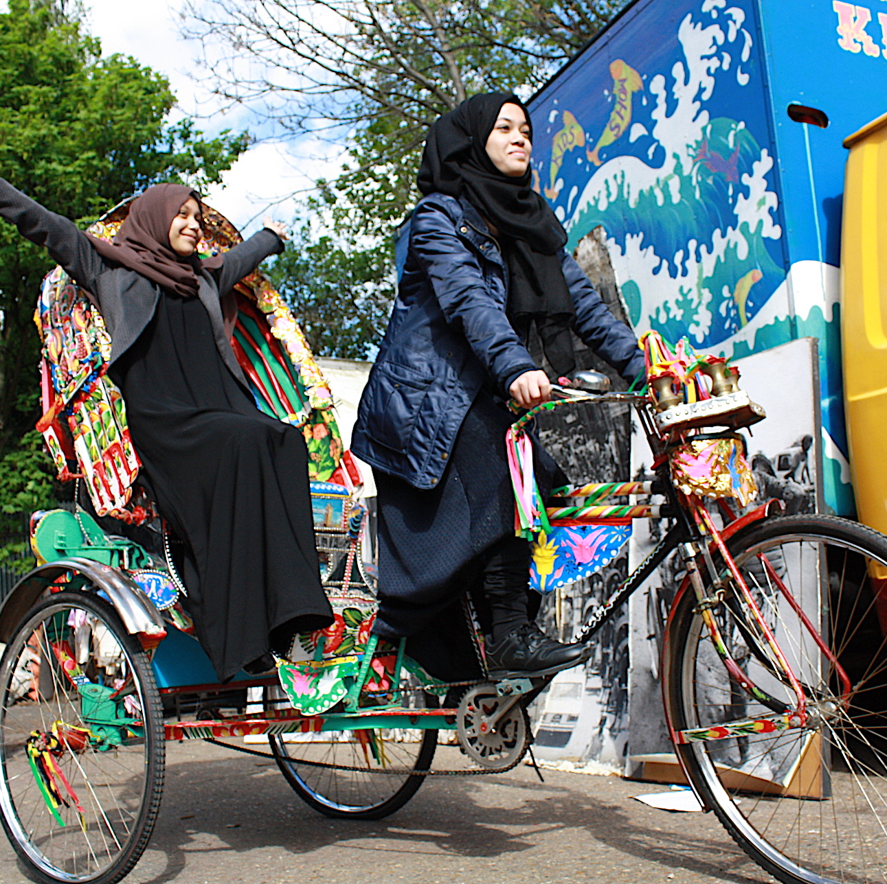
Students
These students see their identities in a small block – at home, as Bengali; at the mosque, as Muslim; at school, as British – and in most cases do not crossover these images, but the project allowed them to break the boundaries and explore identity as a whole person.
(Shamsad, field notes, 2019)
I think making the film also made us think about lots of other stuff … so making the film we could add a bit of that into our geography, history … to be honest anything. It links to anything and everything. (Anisha Student, interview, 2018)
Macleroy, V. & Shamsad, S. (2020): A moving story from Dhaka to London: revealing vibrant identities in young people’s intercultural encounters with mobile art, embroidery and artefacts. Language and Intercultural Communication.

Slide 5
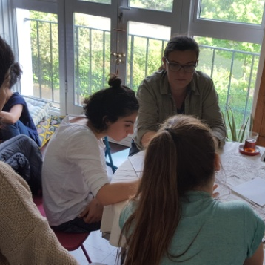
Parents/carers
Oh Crumbs! My mum's speaking English
When children need to interpret for their mums, they sometimes think it's not fair. When mums speak English, sometimes they don't get it right and they think it's not fair either. Does language have any power over belonging?
‘Filming mums was the best part of all!’ (Suzan Student, poster, 2017)
Woking Turkish School

Slide 6
Researchers and Project Team
‘As a classroom community, our capacity to generate excitement is deeply affected by our interest in one another, in hearing one another’s voices, in recognizing one another’s presence’ bell hooks, Teaching To Transgress (1994).
With the time and space to do it, young people can say amazing things through film - Graham Salter (Digital Technology)
Value all my languages and you will know who I am – Dr Jim Anderson (Languages, Culture and Identity)
Young people speak their truth if they think someone’s listening – Dr Anna Carlile (Student Participant Researchers)
Harnessing the potential of drama and digital media, participants can (re)imagine and (re)construct the world around them – Dr Chryso Charalambous (Drama Educator)
A joyfully inclusive experience … despite challenging topics being explored and shared - Jo van de Meer (Film Educator, BFI)
Know incredible digital stories will emerge with time and work - Dr Vicky Macleroy (Multiliteracies Pedagogy)
People connect together despite languages, culture, or nationalities - Dr Yu Chiao (School-home Links)
Age, background, and language are secondary when people create together - Mark Long (Film Making)

Slide 7
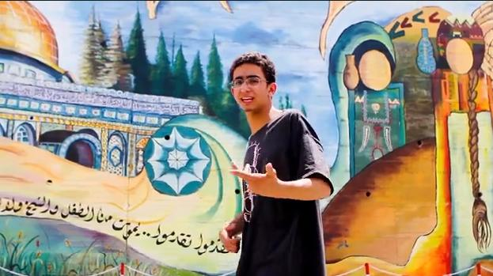
Why digital storytelling?
‘Being the author of your own life, of the way you move through the world, is a fundamental idea in democracy’ (Lambert, 2013: 2).

Slide 8
Multilingual digital storytelling (Anderson & Macleroy, 2016: 4)
Multilingual | Digital | Storytelling
different sounds, words, scripts and patterns | multimodal affordances and design | composition and critical review
different cultural meanings | boundary crossings (school – home) | recognition and reproduction of genres
self-representation (student voice) | collaborative, dialogic orientation | generation of ideas, forming a point of view, presenting to an audience
repertoires (socially, individually) | learner regulated | syncretic identities
connections between languages – metalinguistic awareness | connectedness within the online space (locally and globally) | intertextuality (making connections within and between texts)
translanguaging and dynamic bilingualism | youth culture (self-discovery and belonging) | situated learning within communities of practice

Slide 10
Multilingual digital stories

Slide 11
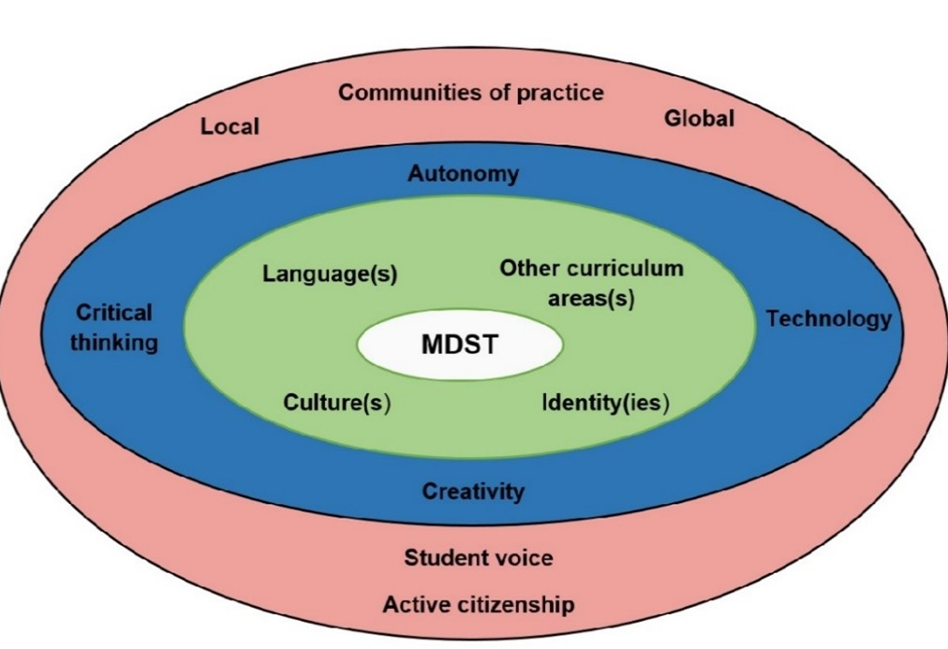
Critical Connections Pedagogical Model
What is it about the Critical Connections approach (2012-ongoing) to learning that has continued to capture the interest of students (6 – 18 years old) from very different backgrounds, cultures and experiences?
How has digital storytelling fostered translingual and transcultural skills?
How has our understanding of multilingual digital storytelling changed over time?
Anderson, J. and Macleroy, V. (Eds) (2016) Multilingual Digital Storytelling: Engaging creatively and critically with literacy. Oxford: Routledge. (Page 232).

Slide 12
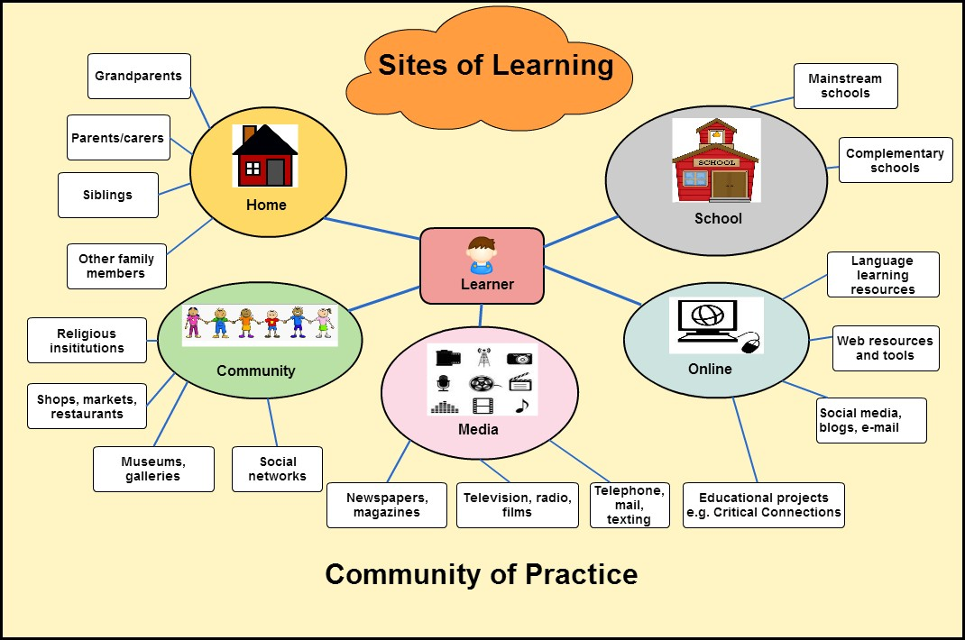
Critical Connections Research Context (2012-22)
Over 2,000 children in a digital storytelling community.
In over 20 languages: Arabic, Bengali, Bulgarian, Chaldean, Croatian, English, Estonian, Filipino (Tagalog), French, German, Greek, Hungarian, Italian, Kurdish, Mandarin Chinese, Polish, Persian, Portuguese, Romanian, Russian, Somali, Spanish, Tamil and Turkish (with either voice-over or subtitles in English).
In over 50 primary, secondary and complementary schools around the globe.
In 15 countries (Algeria, Australia, Cyprus, Egypt, England, Germany, India, Italy, Luxembourg, Malaysia, Palestine, Switzerland, Taiwan, Turkey, U.S.A.) from 2012-2022.

Slide 13
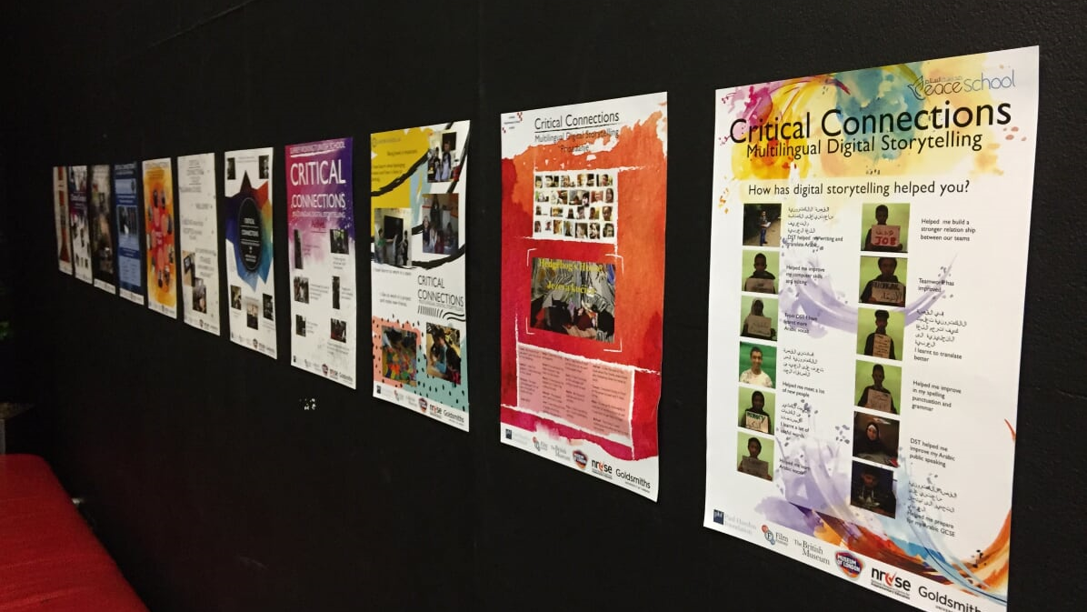
Developing a new mindset towards language education
The young people and their digital stories are a testament to the value of supporting multilingual repertories (whether first or second; foreign or heritage languages) in making sense of our life worlds. These stories are creative, but also critical of the status quo.

Slide 14
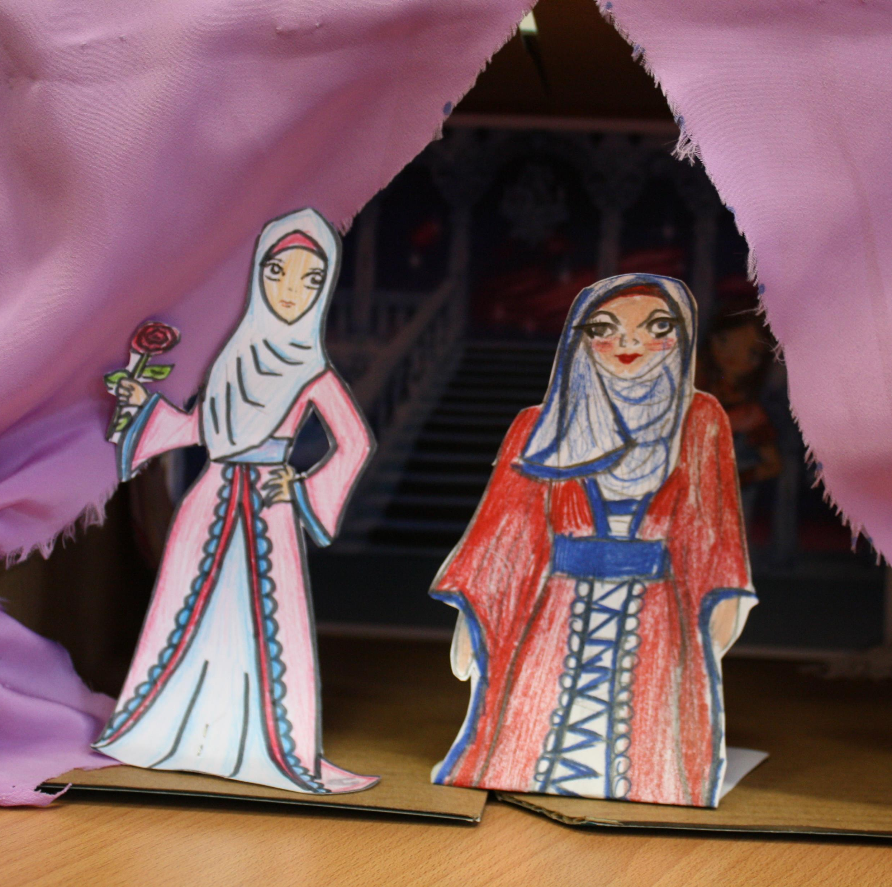
Languages and cultures
Cinderella
Arabic-English
This digital storytelling is about Cinderella “the Arabic version”. The idea is to recreate the main events of Cinderella via reflecting Arabian customs, including clothes, music and language. We used digital images, hand drawings, microphone to record our voice, a camera and lots of discussion and imagination.
https://vimeo.com/149756541
Anderson, J., Macleroy, V., & Chung, Y-C. (2014). Critical connections: Multilingual digital storytelling project. Handbook for teachers. London, UK: Goldsmiths, University of London.

Slide 15
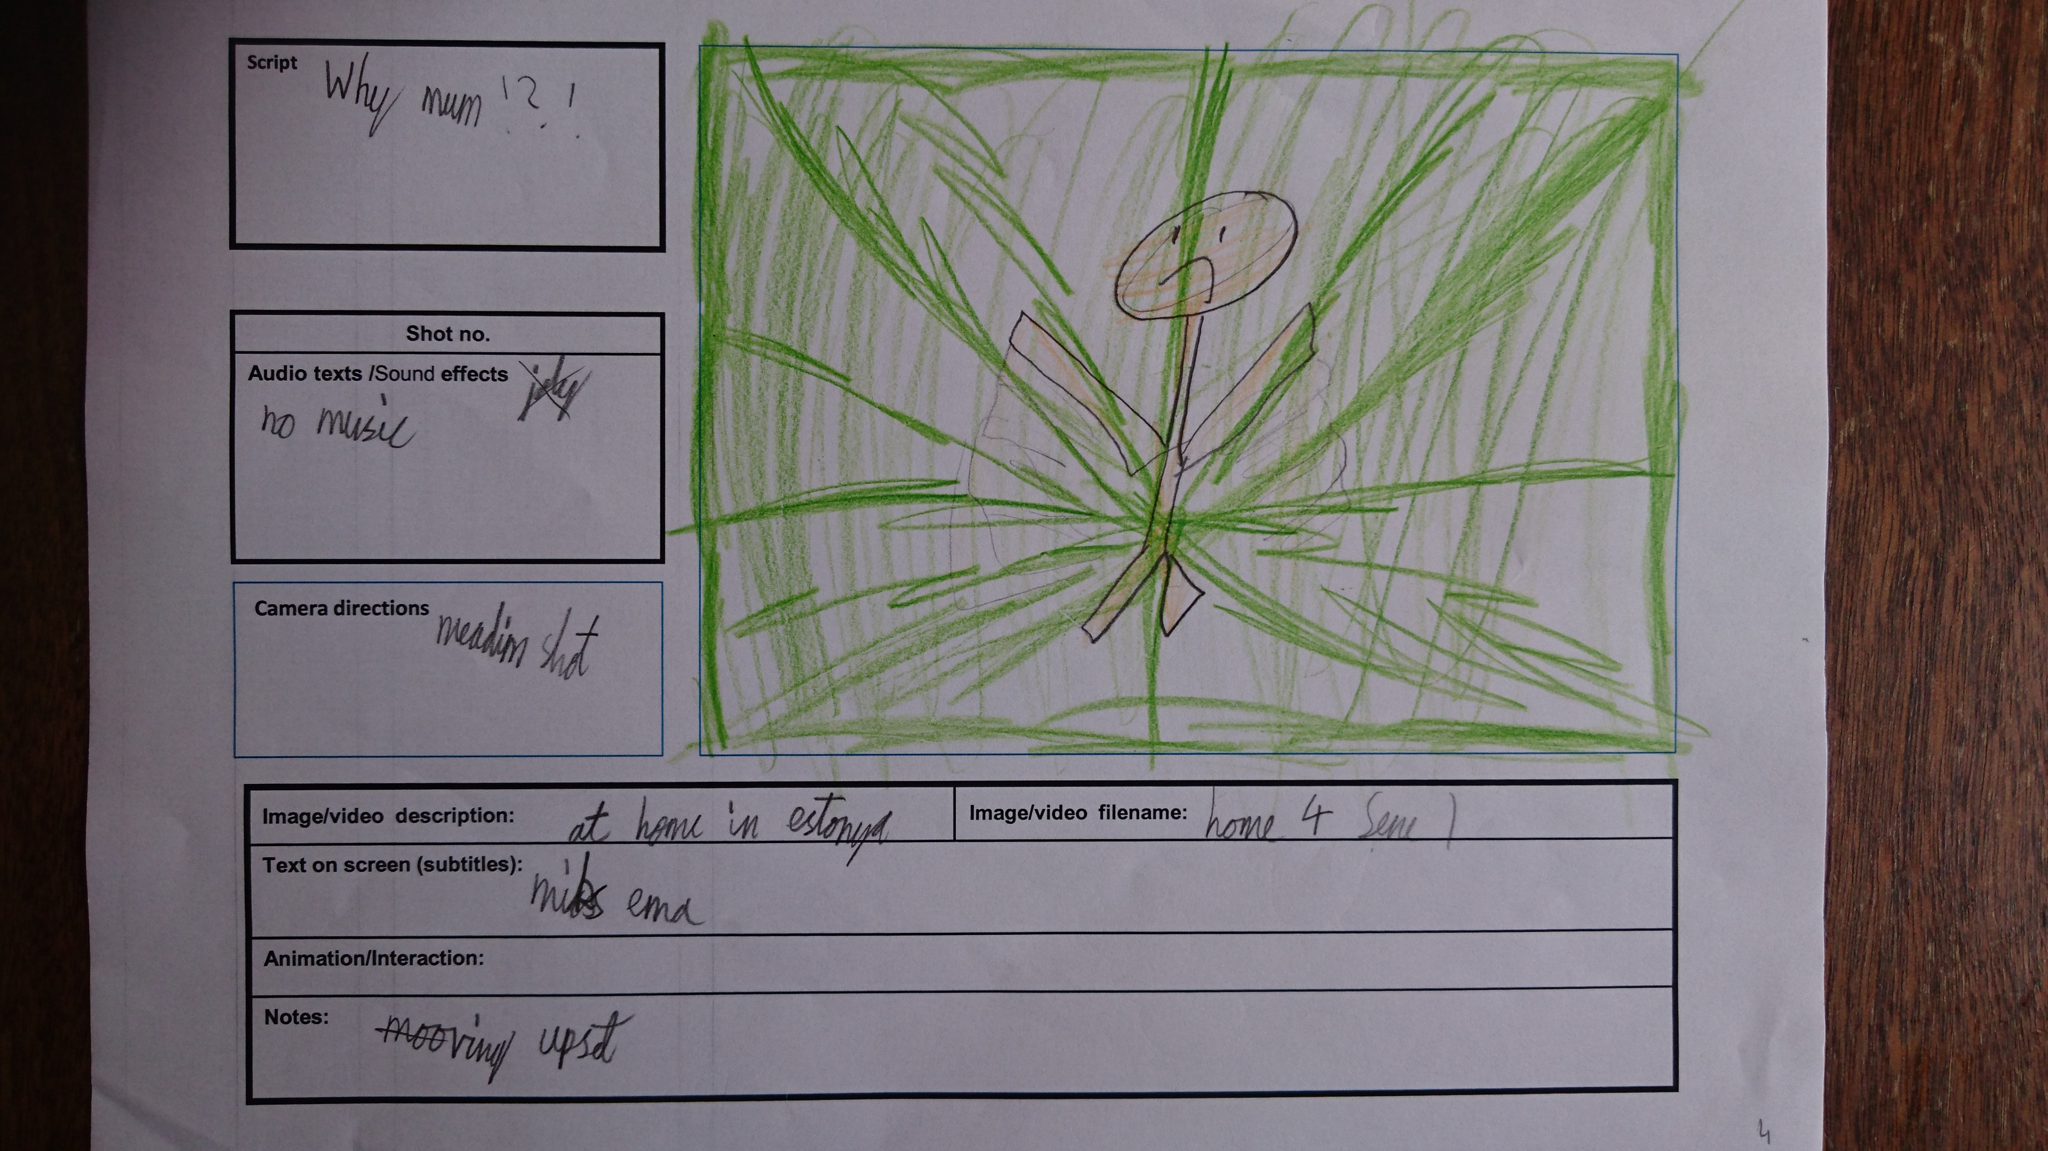
Modes of communication
The Lost Boy and Girl
Estonian-English
Two Estonian children are moving to London with their parents. After a difficult beginning, they realise what belonging means to them. This is a short film made by Sade (Form 2) and Uku (Form 4). The makers have used the stop motion animation technique to bring their Lego bricks to life.
https://vimeo.com/220341659
Macleroy, V. (forthcoming 2022) Siblings’ Multilingual Discourse. In A. Stavans & U. Jessner The Cambridge Handbook of Child and Childhood Multilingualism. Cambridge. Cambridge University Press

Slide 16
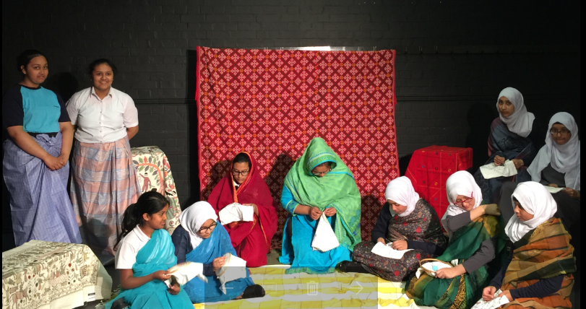
Ways of learning (cognitive, affective, multisensory, aesthetic)
Telling Stories through Needle and Thread
Bengali-English
Nokshi Kantha is an embroidered quilt, made predominantly by unskilled village women from Bangladesh, which is sewn to tell a story. The students from Central Foundation Girls’ School recreated a story called ‘Nokshi Kanthar Math’ by a famous poet called Jasim Uddin, where the main character died of grief after her husband killed a man and left her. Before she died, she made a Nokshi Kantha and left it for her husband to understand her sorrow and grief.
https://vimeo.com/221408979
Macleroy. V. & Shamsad,S. (2020): A moving story from Dhaka to London: revealing vibrant identities in young people’s intercultural encounters with mobile art, embroidery and artefacts, Language and Intercultural Communication

Slide 17
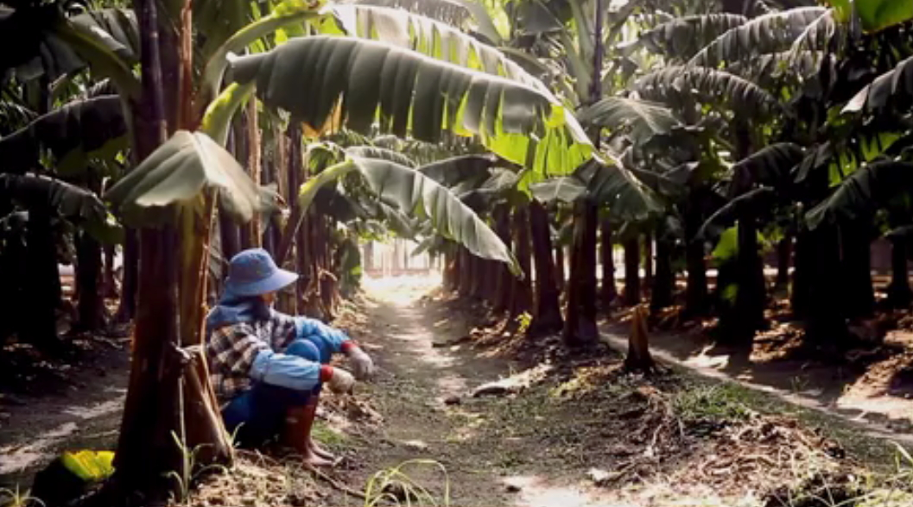
Crossing curriculum borders
How weird is weird?
Mandarin Chinese-English
In our life, it is not unusual to see people who act a bit differently from others, such as a girl-like boy or a boy-like girl. Some might label them as being “weird”. But wouldn’t it be weird when we try all out to be different from others but show little tolerance to others’ being different? Though this digital story , we hope to raise the public awareness of gender-related bullying on campus and call for the fair treatment for those being stereotyped or discriminated. Thanks to them, we are able to live in a world that is colourful and beautiful.
https://vimeo.com/169446882
Chung, Y-C. & Macleroy, V. (Forthcoming, Feb 2022) How Weird is Weird? Young people, activist citizenship and multivoiced digital stories. In V. Lytra, C. Ros-i-Solé, J. Anderson, V. Macleroy (Eds): Liberating Language Education. Bristol: Multilingual Matters.

Slide 18
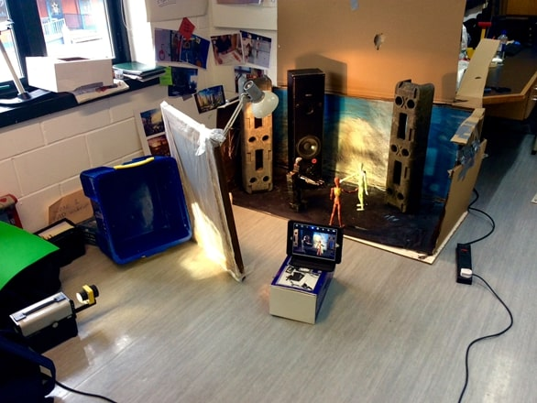
Transformative pedagogy
The B.A.D. Robot
Hungarian-Portuguese-English
After a decade of war and conflicts, the world has finally achieved total peace. However, the past should never be forgotten. An old robot from the far past, finally wakes up after a 100 years nap. This may just change everything he knows. Does he still belong to this world? This is a trilingual movie, with dialogues in English, Hungarian and Portuguese.
https://vimeo.com/220581681
Anderson, J. and Macleroy. V. (2021) Stories, Communities, Voices: revitalising language learning through digital media within a project-based framework. M. Thomas & K. Yamazaki (Eds) Project-based Language Learning and CALL: Theory and Practice. Texas: CALICO.

Slide 19
School, home, local and global communities
The Indestructible Belonging
Mandarin Chinese-English
This film was created by the Year 5 children and facilitated by the teacher. This film is about how the Pingpu Tribe is fighting for their long-lost recognition of being aborigines. The children visited their community and spoke to the elders in the Tribe as well as scholars. They surprisingly found some old photographs taken by a British photographer. This is their story and they would like to share with you and with their descendants.
https://vimeo.com/221545542
Chung, Y-C. & Macleroy, V. (Forthcoming, Feb 2022) How Weird is Weird? Young people, activist citizenship and multivoiced digital stories. In V. Lytra, C. Ros-i-Solé, J. Anderson & V. Macleroy (Eds): Liberating Language Education. Bristol: Multilingual Matters.

Slide 20
Becoming a multilingual activist
How can the Critical Connections MDST project make change happen?
Supporting multilingual repertories (whether first or second; foreign or heritage languages).
Understanding young people’s digital stories are creative, but also critical of the status quo.
Challenging the lack of imagination and time given in our current educational systems to local languages and cultures.
Recognising project-based learning as a key way to open spaces for multilingualism.
Seeing schools as the stepping off point to provide resources and structures for project-based learning to happen.
Acknowledging communities, both offline and online, can provide real audiences and feedback for students’ work.
Opening up opportunities for activist citizenship.
Valuing children’s multilingualism as vital to their sense of identity and well-being and the way they learn and access the curriculum.
Anderson, J. & Macleroy, V. (November, 2021) What is a multilingualism activist? Multilingual moves: Changing the mindset of teachers and policy makers. In A. de Medeiros & D. Kelly (Eds) Language Debates. London: Hodder and Stoughton Publishers.

Slide 21
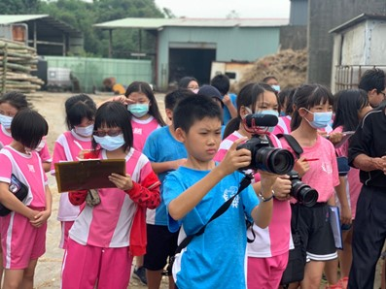
Young multilingual environmental activists
Our Planet Digital Festival 2021
The digital storytelling festival connects young people with their environment, cultural heritage, and languages. The festival celebrates the multilingual lives of young people through the bi- and multi- lingual digital stories they have created during the pandemic.
https://goldsmithsmdst.com/digital-stories/

Slide 22
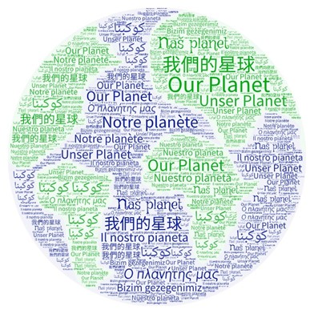
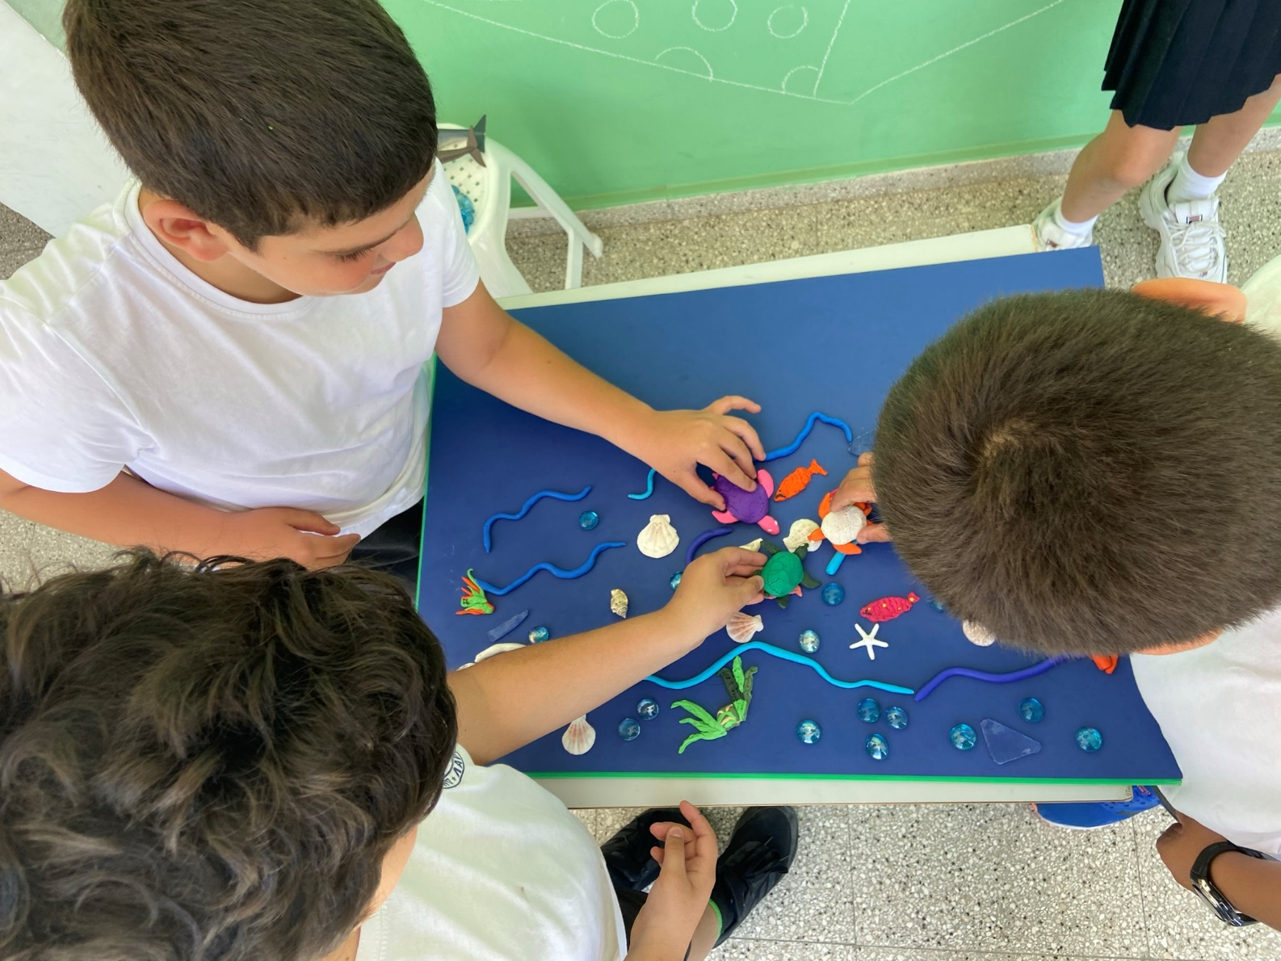
Critical Connections Project 2021-22
Aims of the Our Planet Film Festival 2022 (Over 30 primary, secondary, complementary schools in 11 different countries)
Connect young participants with their environment, cultural heritage, and languages through taking action and telling stories on issues that matter to them (cosmopolitan citizenship).
Connect young participants with each other locally and globally.
Develop young participants’ imagination, creativity, and multilingual repertories.
Improve young participants communication skills and ability to make meaning through narrative and still/moving images and gain understanding of multimodal literacy and intertextual relationships.
Gain understanding of issues and strategies in translation activities and subtitling (metalinguistic awareness).
Enable creative and critical use of digital technology to transform stories.
Encourage critical thinking, activist citizenship, and international partnerships.
Develop young participants’ understanding of aesthetics and narration through creating artwork and poetry.
https://goldsmithsmdst.com/project-brief-2021/

Slide 23
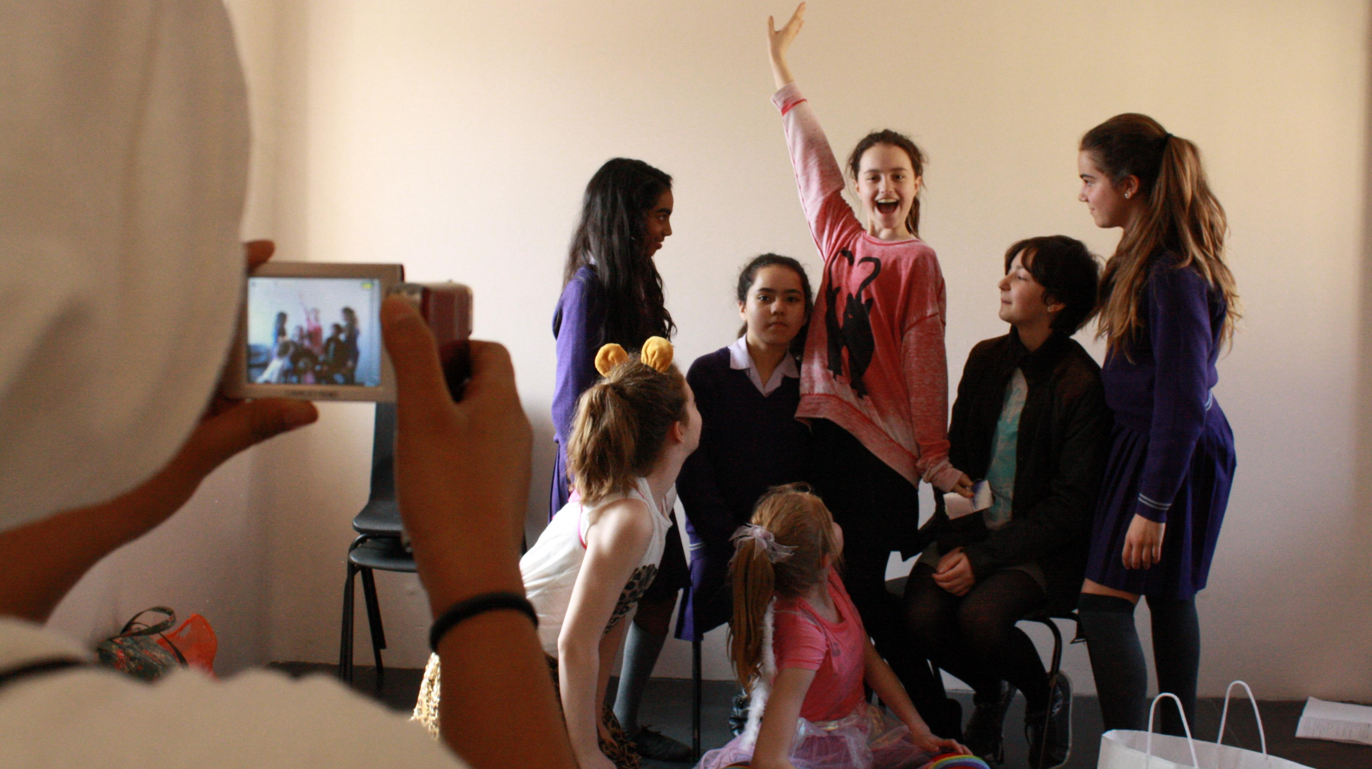
Critical Connections MDST resources
Website: https://goldsmithsmdst.com/
Handbook: https://goldsmithsmdst.com/handbook/
Research: https://goldsmithsmdst.com/book/
Blog: https://goldsmithsmdst.com/blog/

